Slide 1
Using SNOMED CT for real world clinical data research and population health analytics
Charles Gutteridge
CCIO Barts Health NHS Trust
Clinical Engagement SNOMED International
Scientific Data
Resources Forum
October 2023

Slide 2
Towards the end Goal of static record Becoming Interactive Machine
Creating utility at the point of care
Translating a record for global health
Messaging the content of a record
Health data use by patients and citizens
Aggregating records for population health
Real world data for research

Slide 3
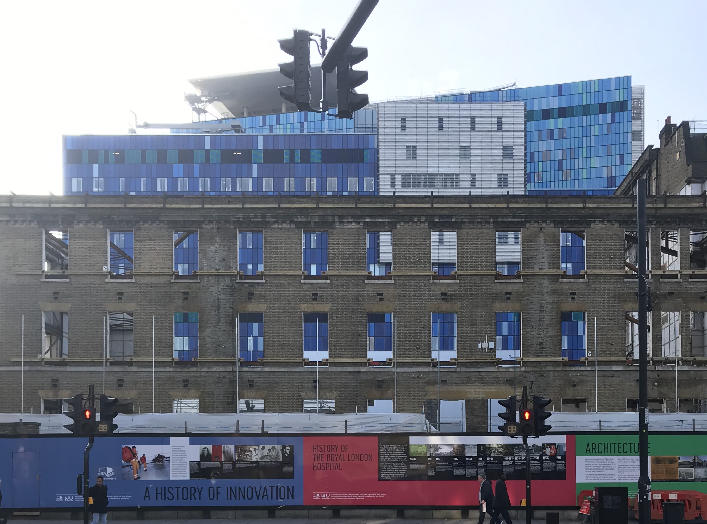

Slide 4
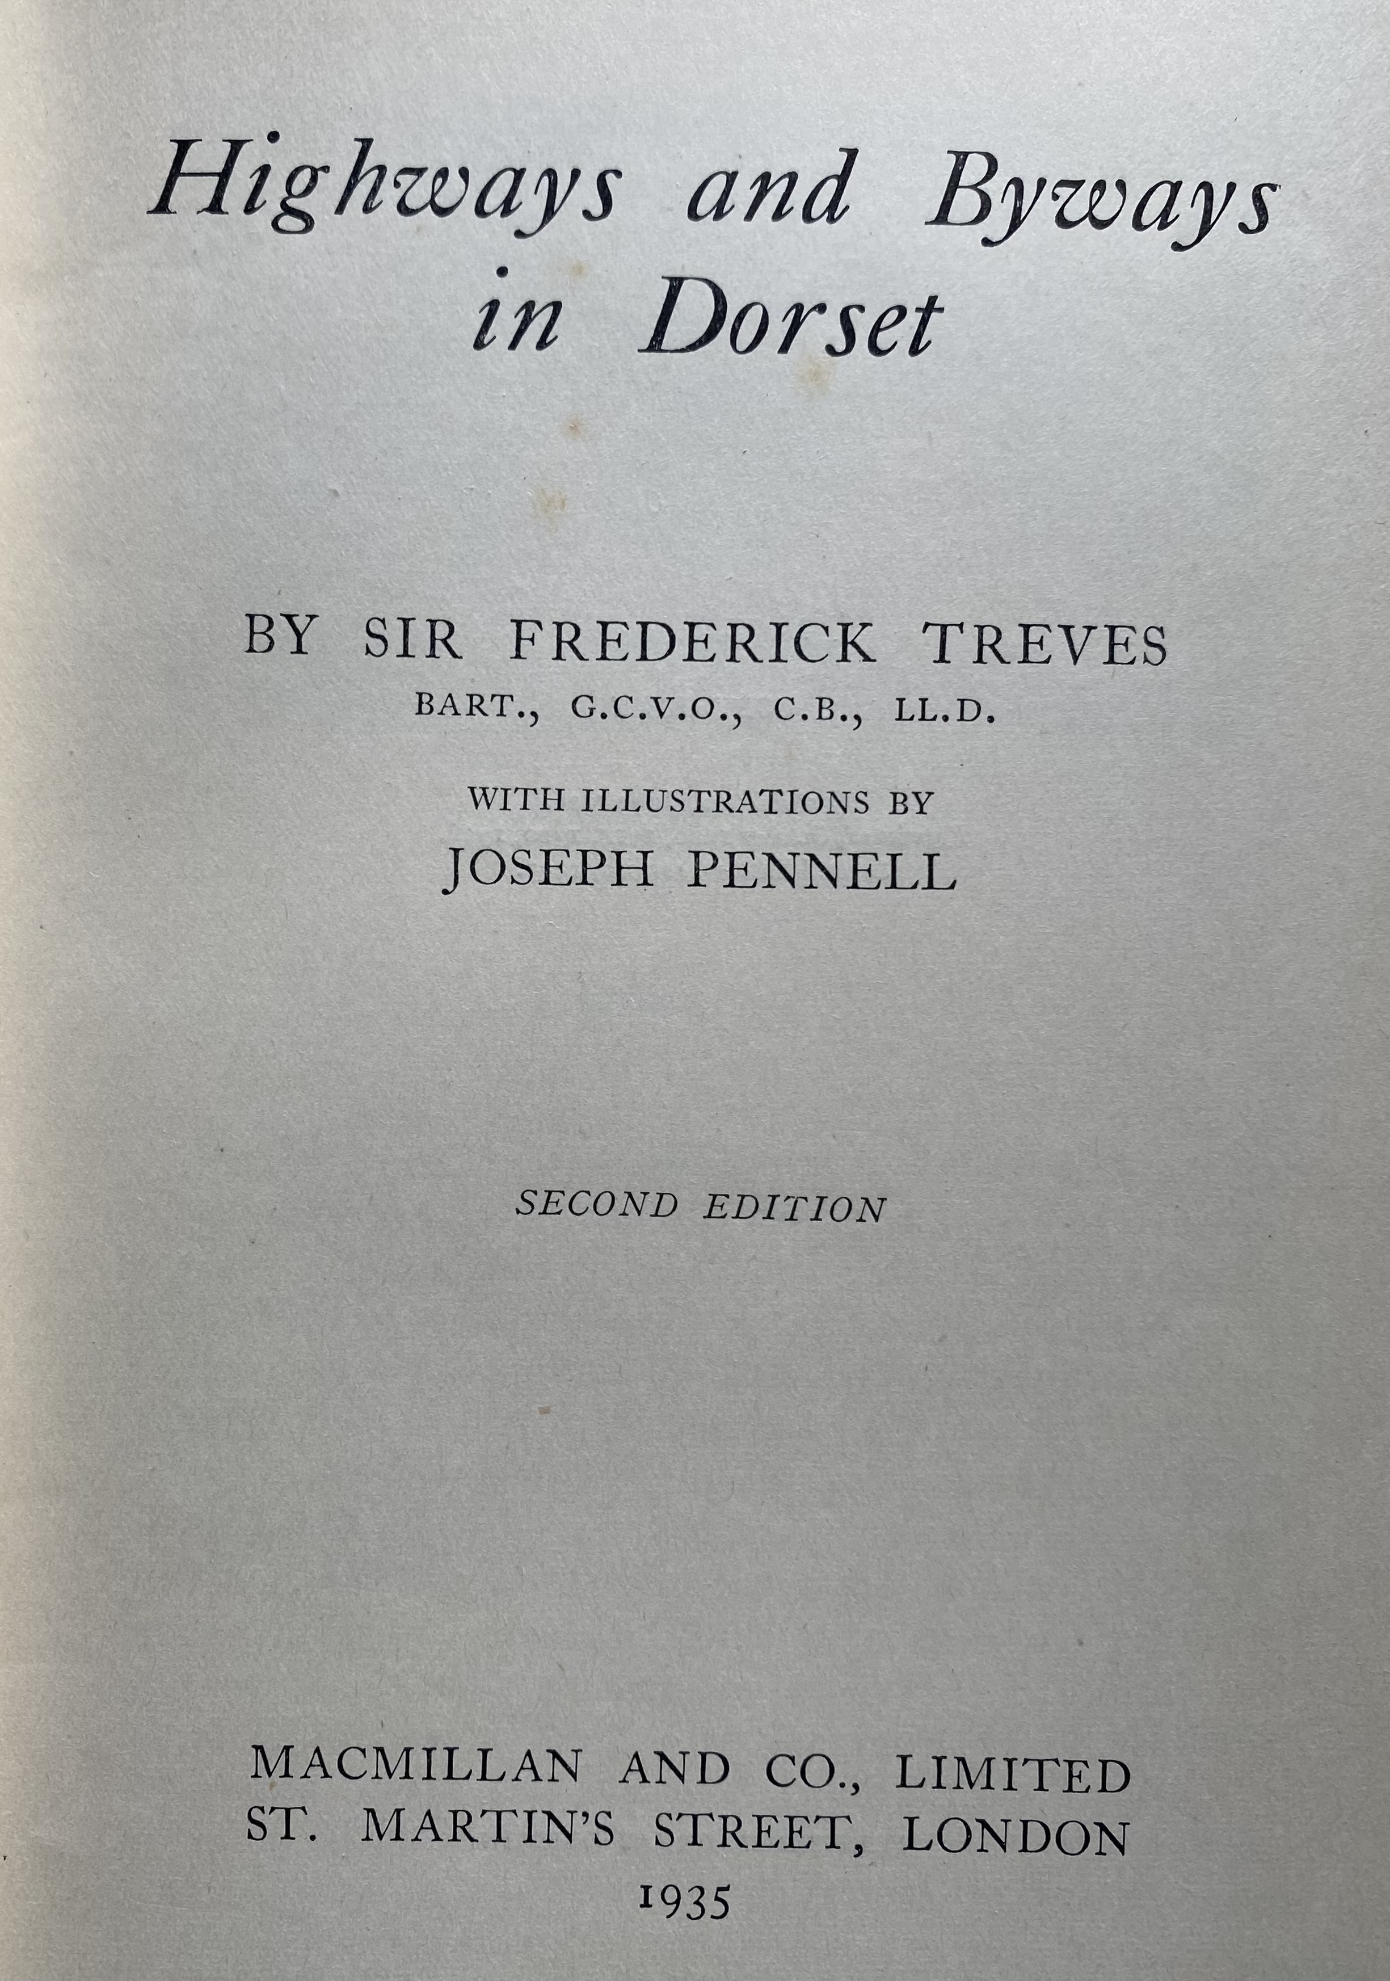
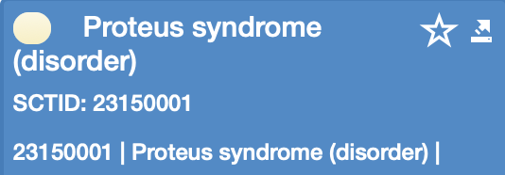
And Proteus Syndrome

Slide 5
Try this at home
http://lookup.snomedtools.org

Slide 7
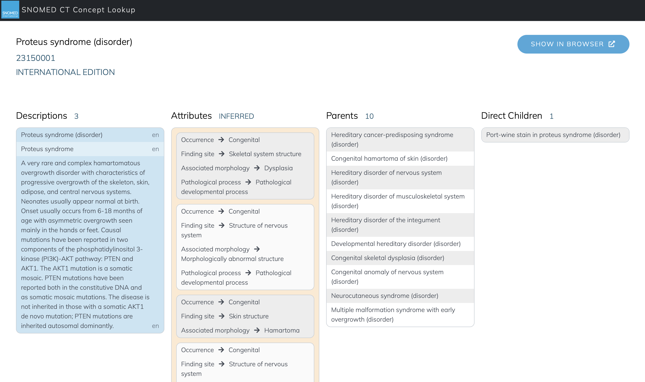

Slide 9
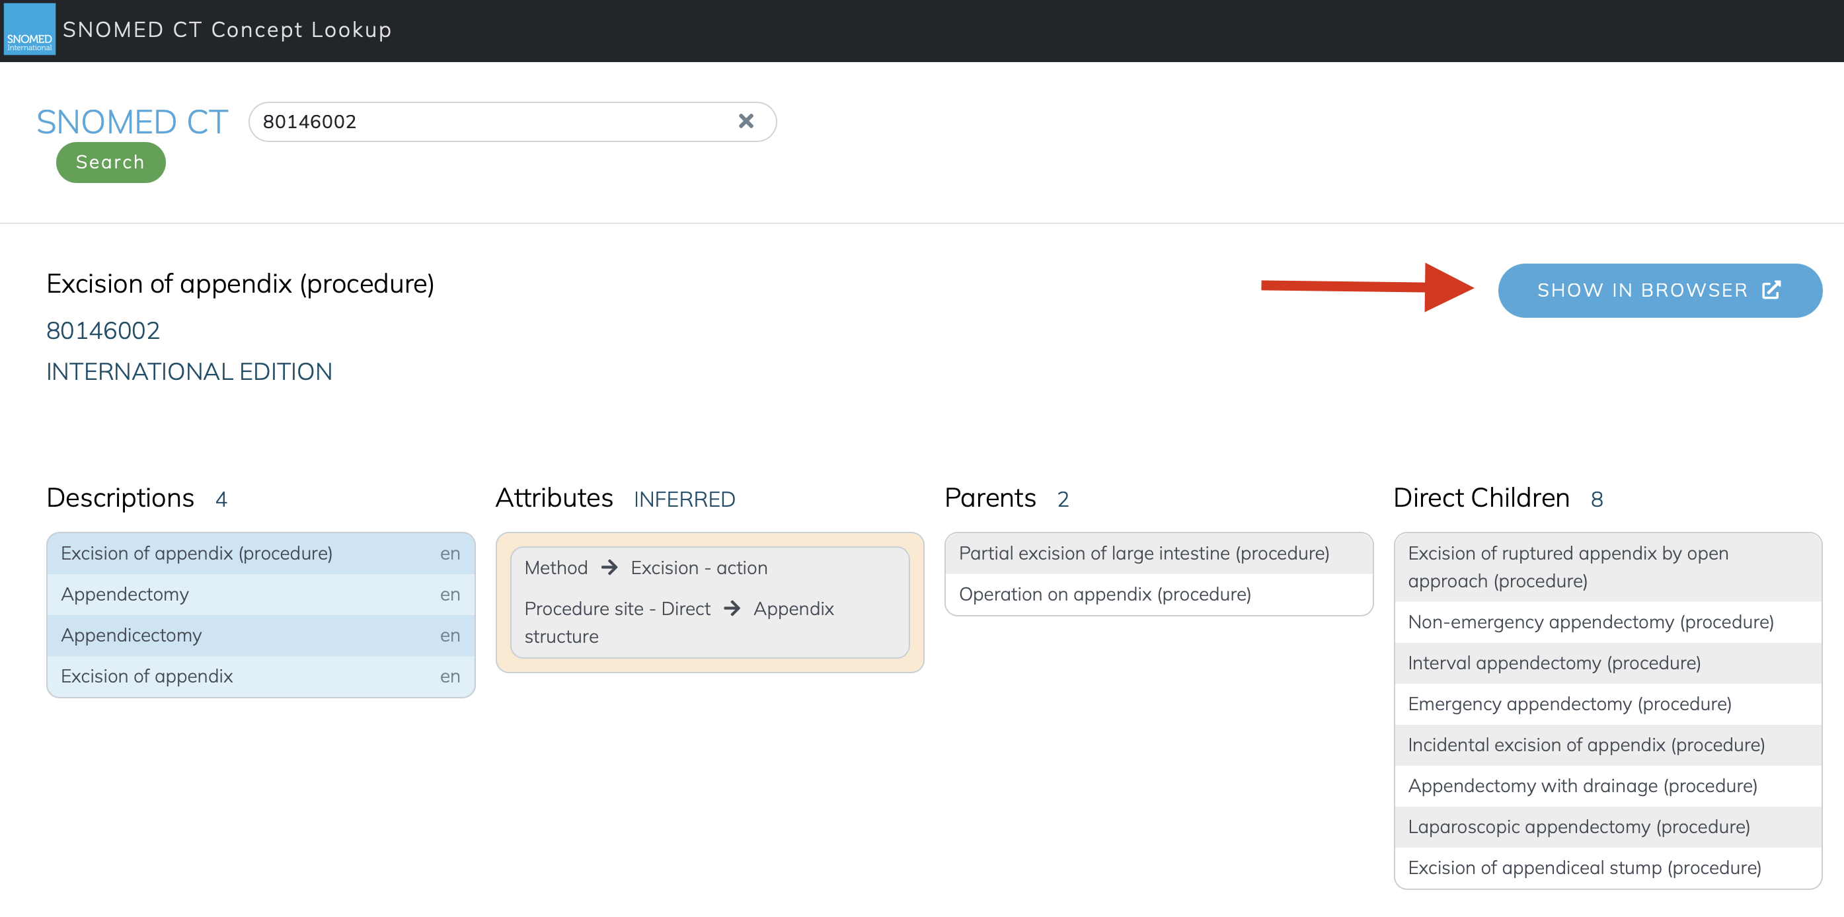

Slide 10
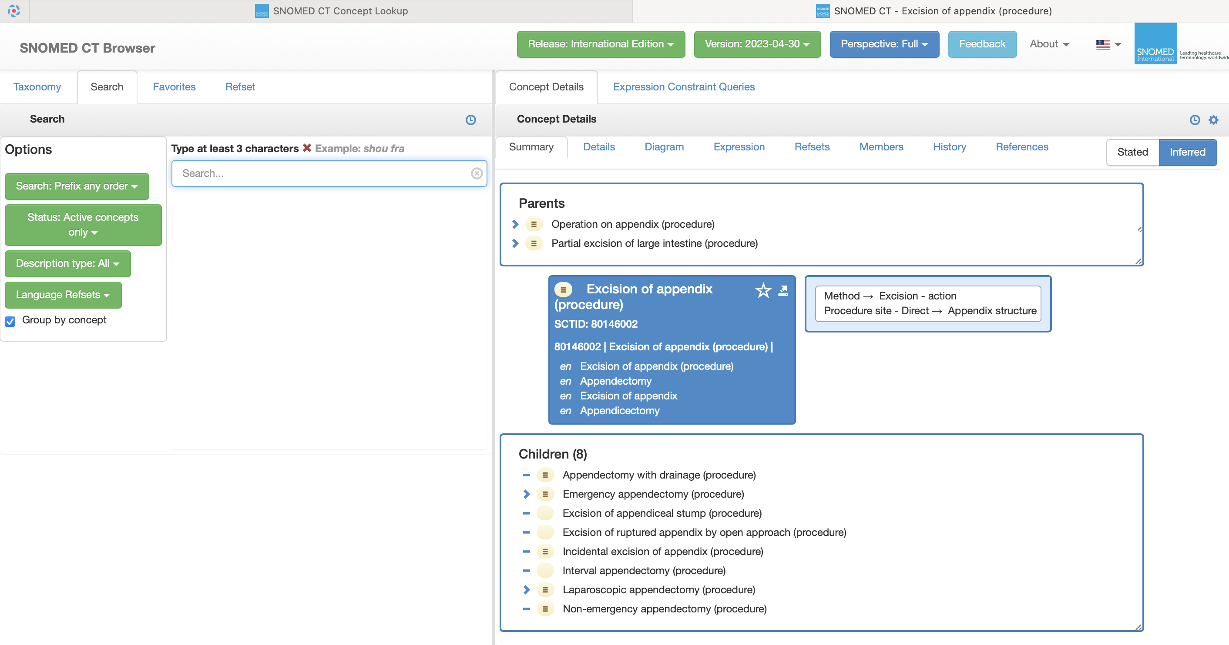

Slide 11
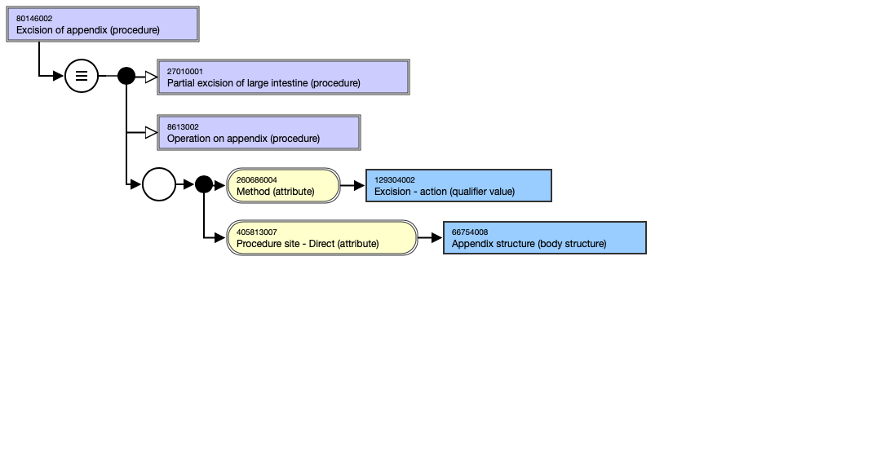

Slide 12
Pre-coordinated expression
80146002 |Excision of appendix (procedure)|

Slide 13
Expression from class axiom definition
EquivalentClasses(
:80146002 |Excision of appendix (procedure)|
ObjectIntersectionOf(
:71388002 |Procedure (procedure)|
ObjectSomeValuesFrom(
:609096000 |Role group (attribute)|
ObjectIntersectionOf(
ObjectSomeValuesFrom(
:260686004 |Method (attribute)|
:129304002 |Excision - action (qualifier value)|
)
ObjectSomeValuesFrom(
:405813007 |Procedure site - Direct (attribute)|
:66754008 |Appendix structure (body structure)|
)
)
)
)
)

Slide 14
Expression from inferred concept definition
=== 27010001 |Partial excision of large intestine (procedure)| + 8613002 |Operation on appendix (procedure)| : { 260686004 |Method (attribute)| = 129304002 |Excision - action (qualifier value)|, 405813007 |Procedure site - Direct (attribute)| = 66754008 |Appendix structure (body structure)| }

Slide 15
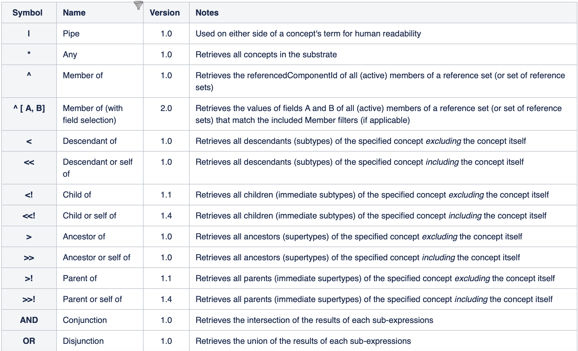

Slide 16
Machine readable code
25876001
12934002
26068004
268087009
174041007
425391005
405813007
86174004
116680003
66754008
71388002

Slide 17
Human readable equivalents
116680003 |Is a (attribute)|
71388002 |Procedure (procedure)|
260686004 |Method|
129304002 |Excision - action (qualifier value)|
405813007 |Procedure site - Direct (attribute)|
66754008 |Appendix structure (body structure)|
260870009 |Priority (attribute)|
25876001 |Emergency (qualifier value)|
425391005 |Using access device (attribute)|
86174004 |Laparoscope, device (physical object)|
174041007 |Laparoscopic emergency appendectomy (procedure)|

Slide 18
Decoded for humans
25876001 |Emergency (qualifier value)|
129304002 |Excision - action (qualifier value)|
260870009 |Priority (attribute)|
260686004 |Method (attribute)|
174041007 |Laparoscopic emergency appendectomy (procedure)|
405813007 |Procedure site - Direct (attribute)|
425391005 |Using access device (attribute)|
116680003 |Is a (attribute)|
66754008 |Appendix structure (body structure)|
86174004 |Laparoscope, device (physical object)|
71388002 |Procedure (procedure)|

Slide 19
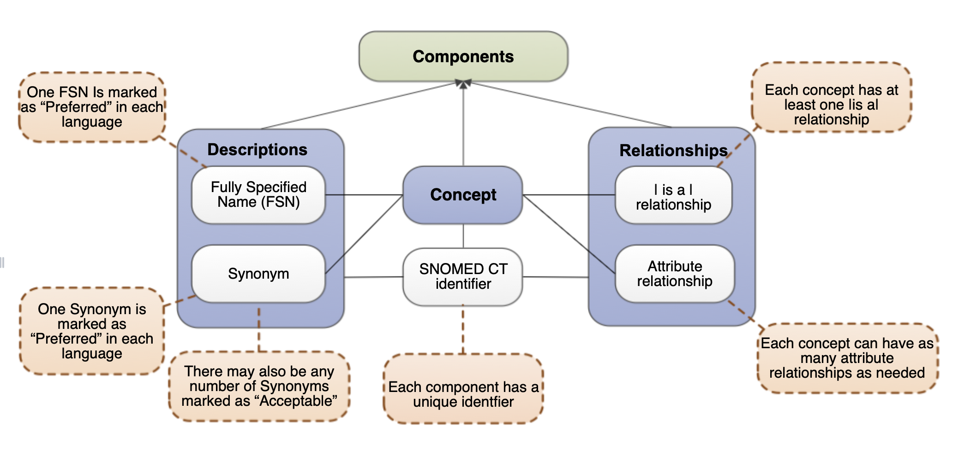

Slide 20
Interface terminologies From NLP to Maps to Reference Sets

Slide 21
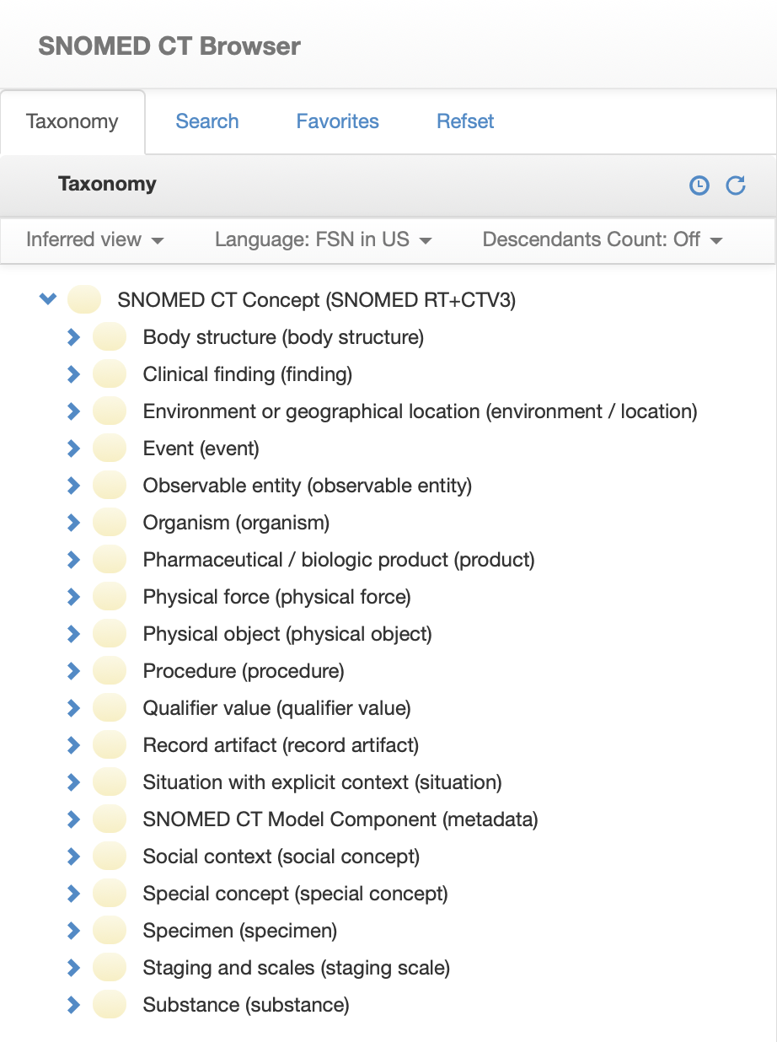
Browser

Slide 22
Using SNOMED Relationships
Subtype
Relationship
Is_A
Aggregation
Finding cohorts
Concepts
Attribute
Relationship
Has a
value
Semantic
queries

Slide 23
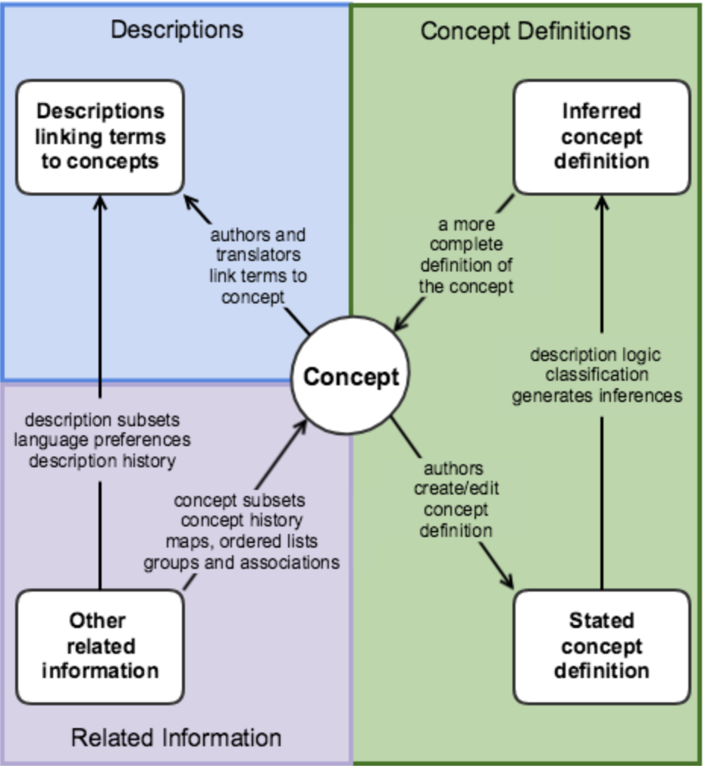

Slide 24
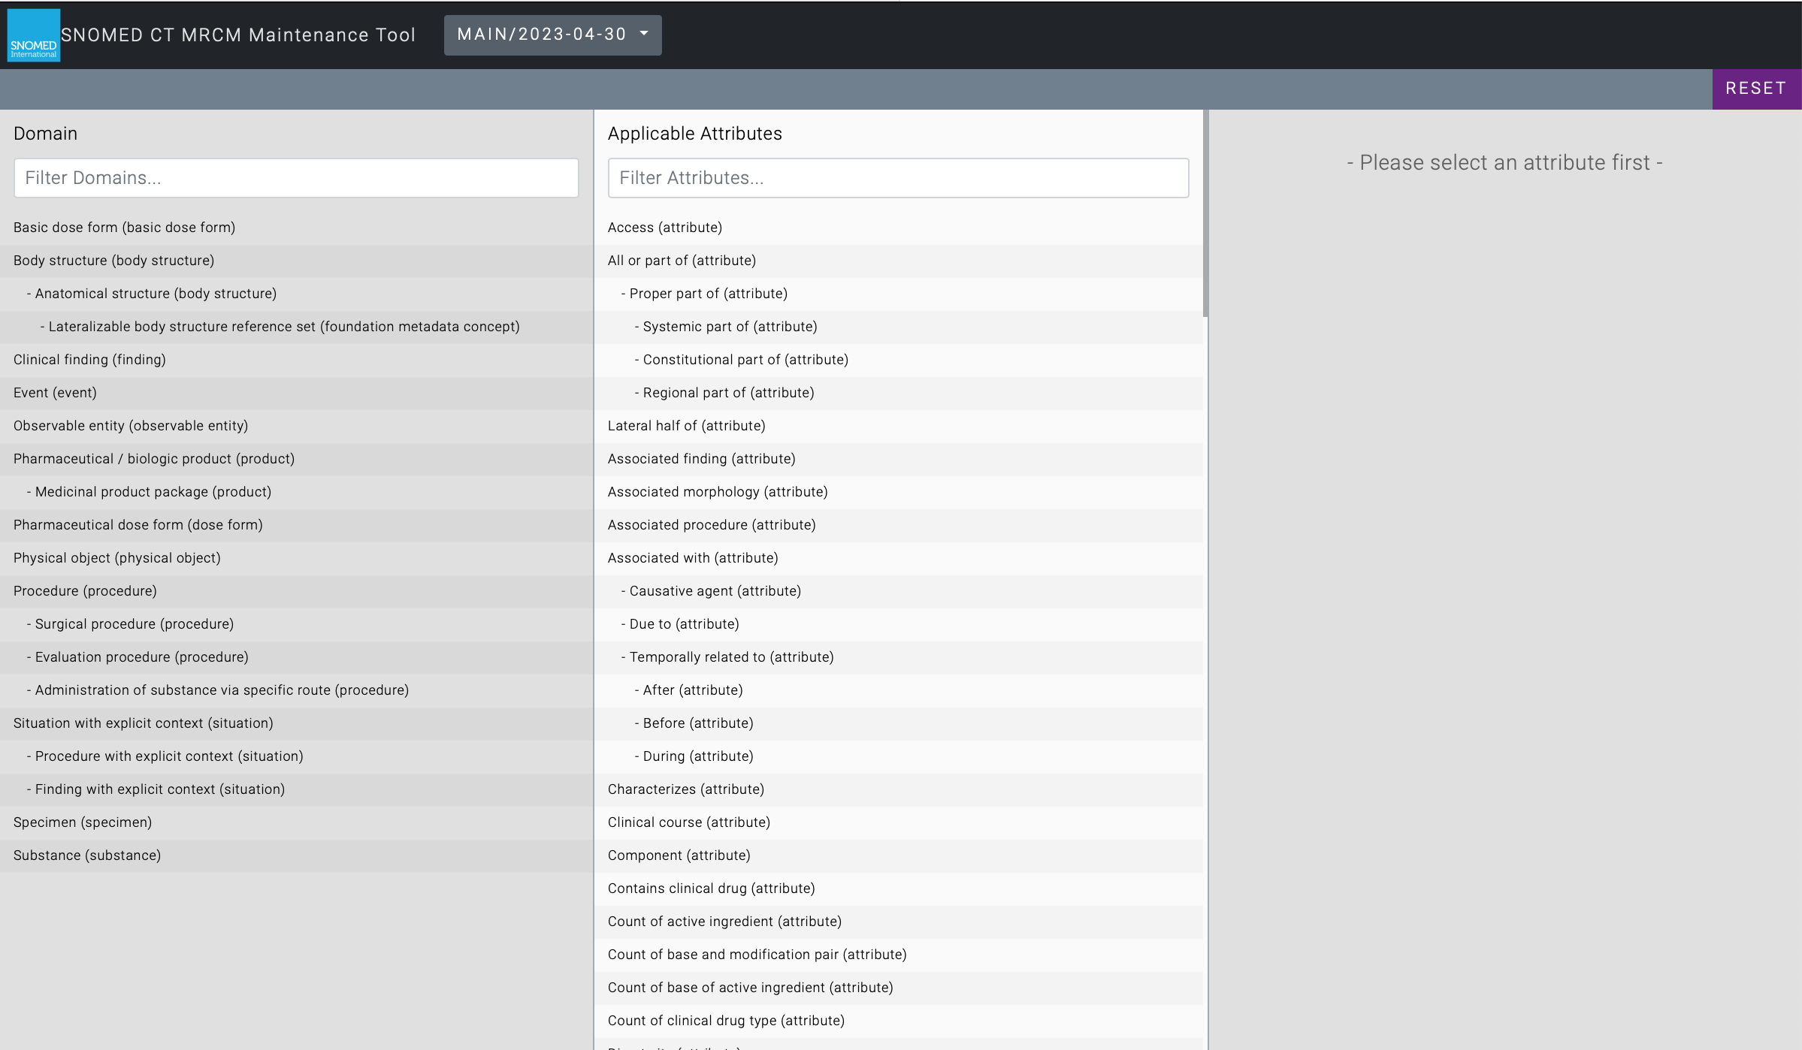
Demonstration of a human view of the Machine Readable Concept Model showing procedure domain
and allowable relationships and attribute relationships
https://browser.ihtsdotools.org
MRCM

Slide 25
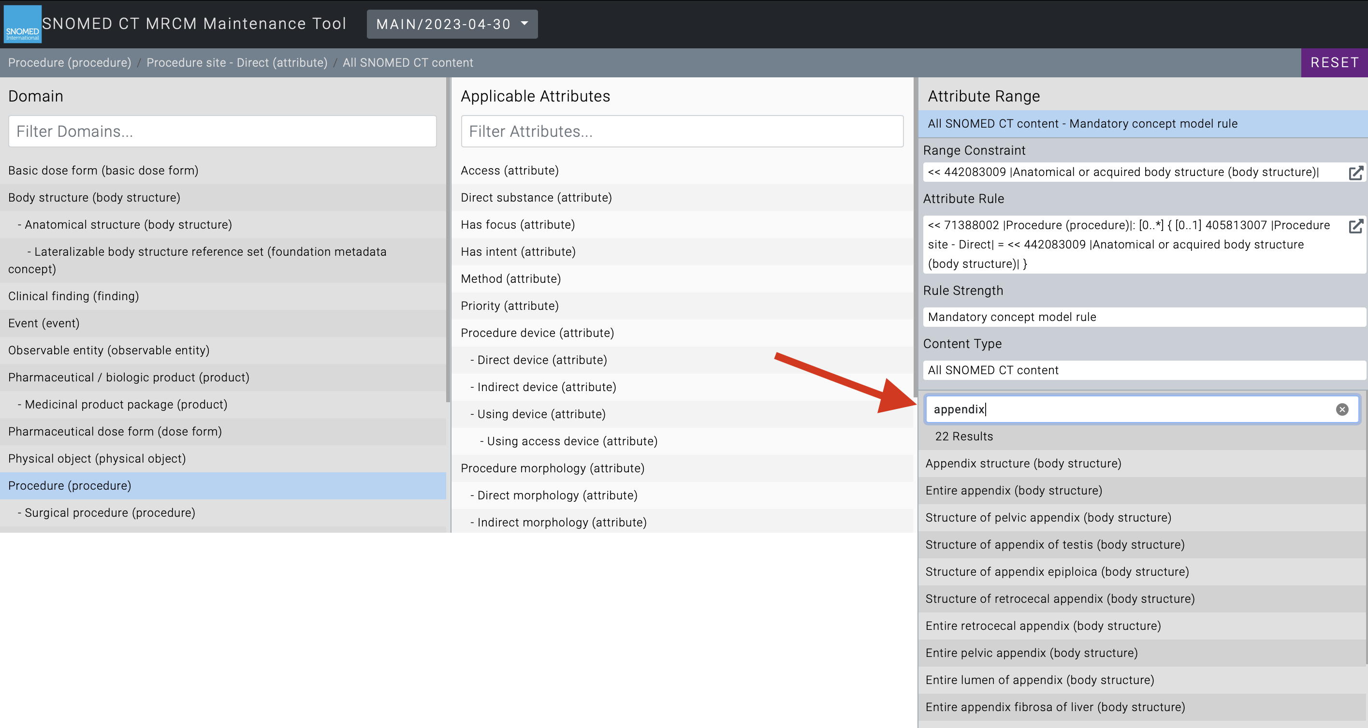

Slide 26
Real world data questions

Slide 27
Show me all the Genes with somatic
mutations in Biobank samples with
SNOMED Clinical Term for Breast Cancer
and reference with Pharma database
to show me all Compounds known to
modulate those Genes

Slide 28
a
Free text documents
+ local additions
Restricted SNOMED dictionary
Barts Health Data Warehouse
Natural Language Processing
medications
Structured data tables
b
Code lists
Research ready structured data
Code lists
ECL query
ValueSet + Code lists
Current high level architecture for Natural
Language Processing of Electronic Health Record documents
Notes:
F1.
Code lists: ICD10, OPCS4, forms

Slide 29
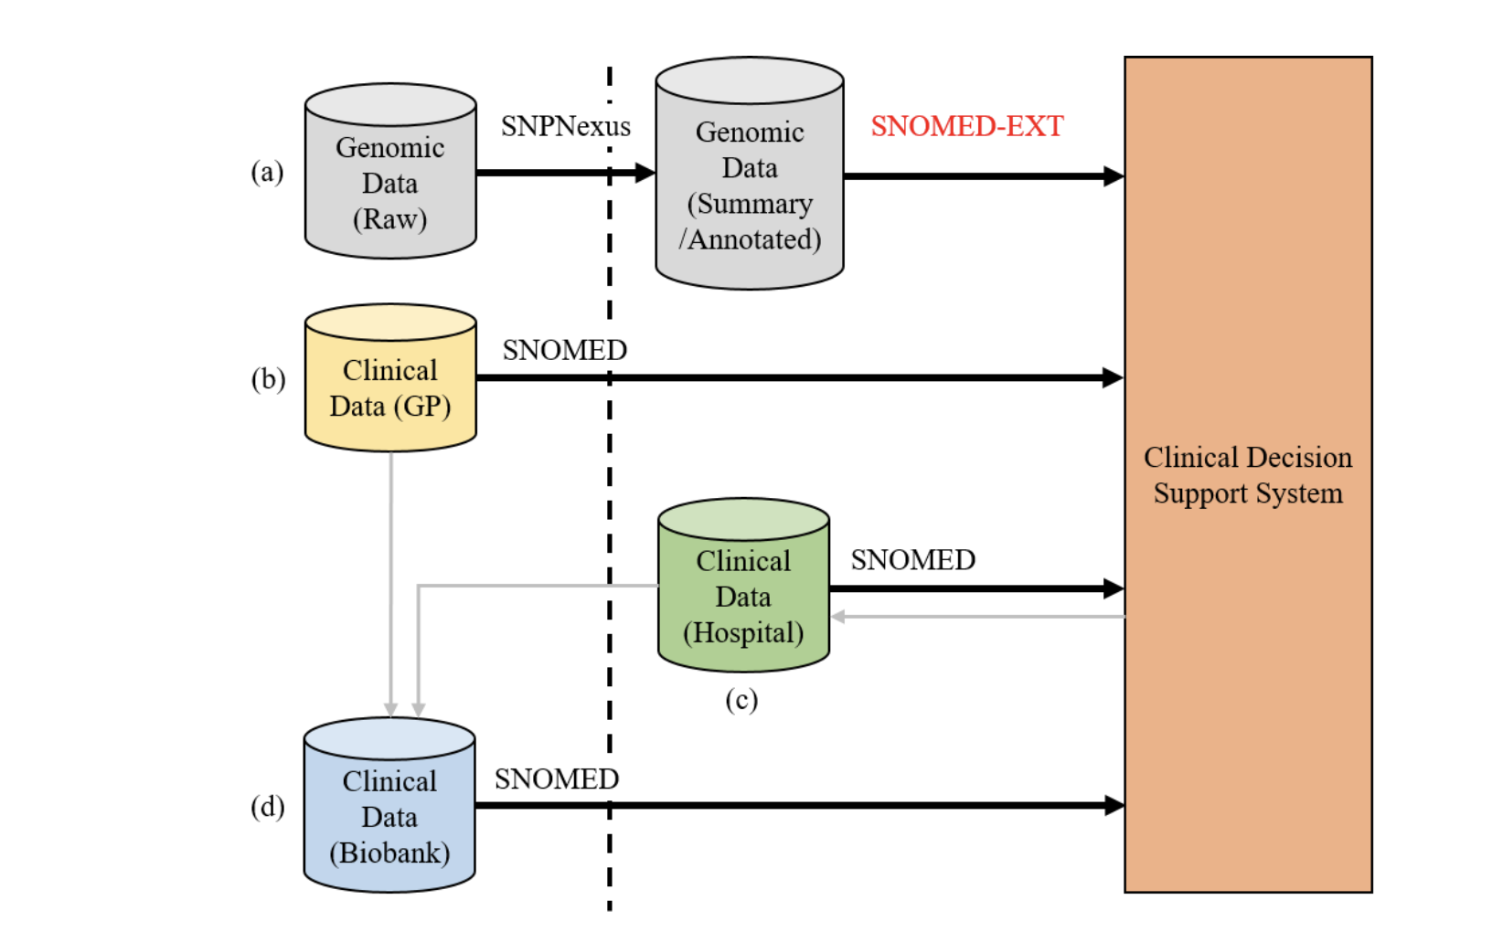

Slide 30
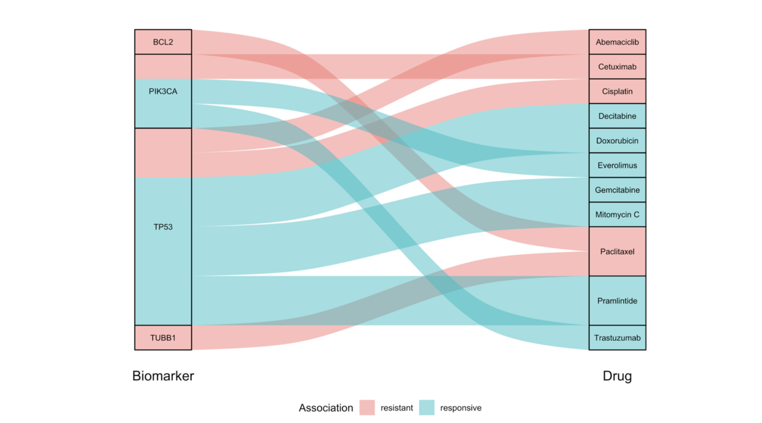
Obtaining value from the output

Slide 32
Show me all the Procedures performed
on the gastrointestinal tract, with appearance of surgical perforation and reference with prescribing database to show me all products containing anti-inflammatory agent or immunosuppressant

Slide 33
Some key steps
SNOMED CT concepts recorded in your EHR
Develop SNOMED CT concept list that matches query definition
Use Expression Constraint Language query

Slide 34
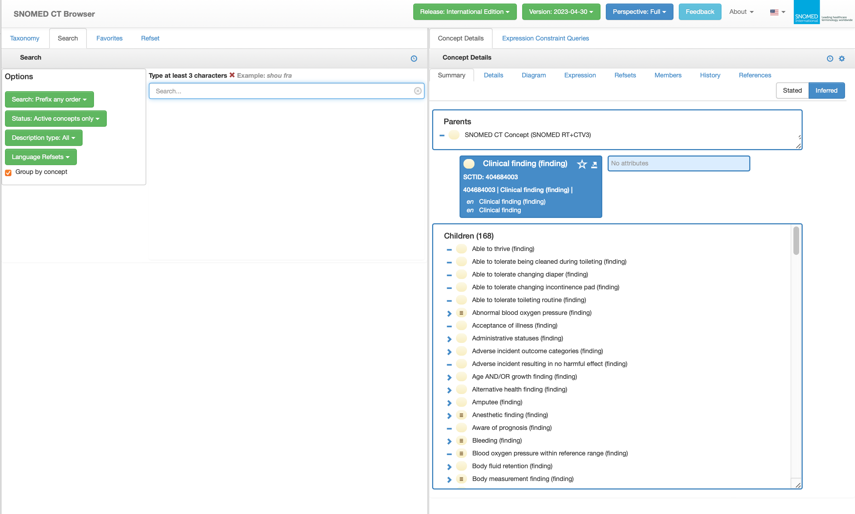
Demonstration of use of ECL
https://browser.ihtsdotools.org
Browser for ECL

Slide 35
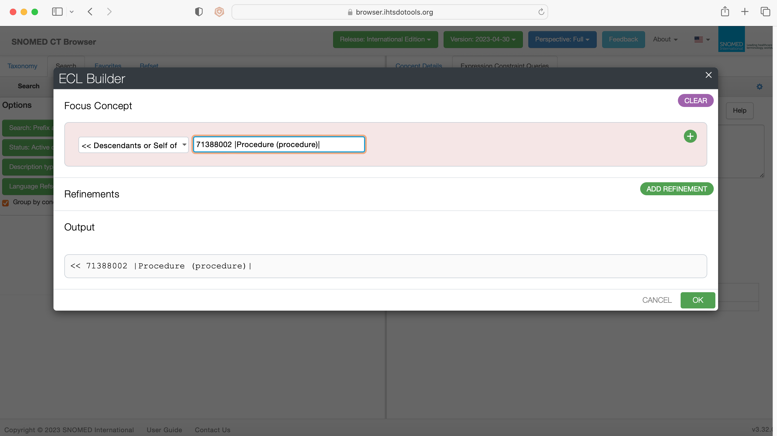

Slide 36
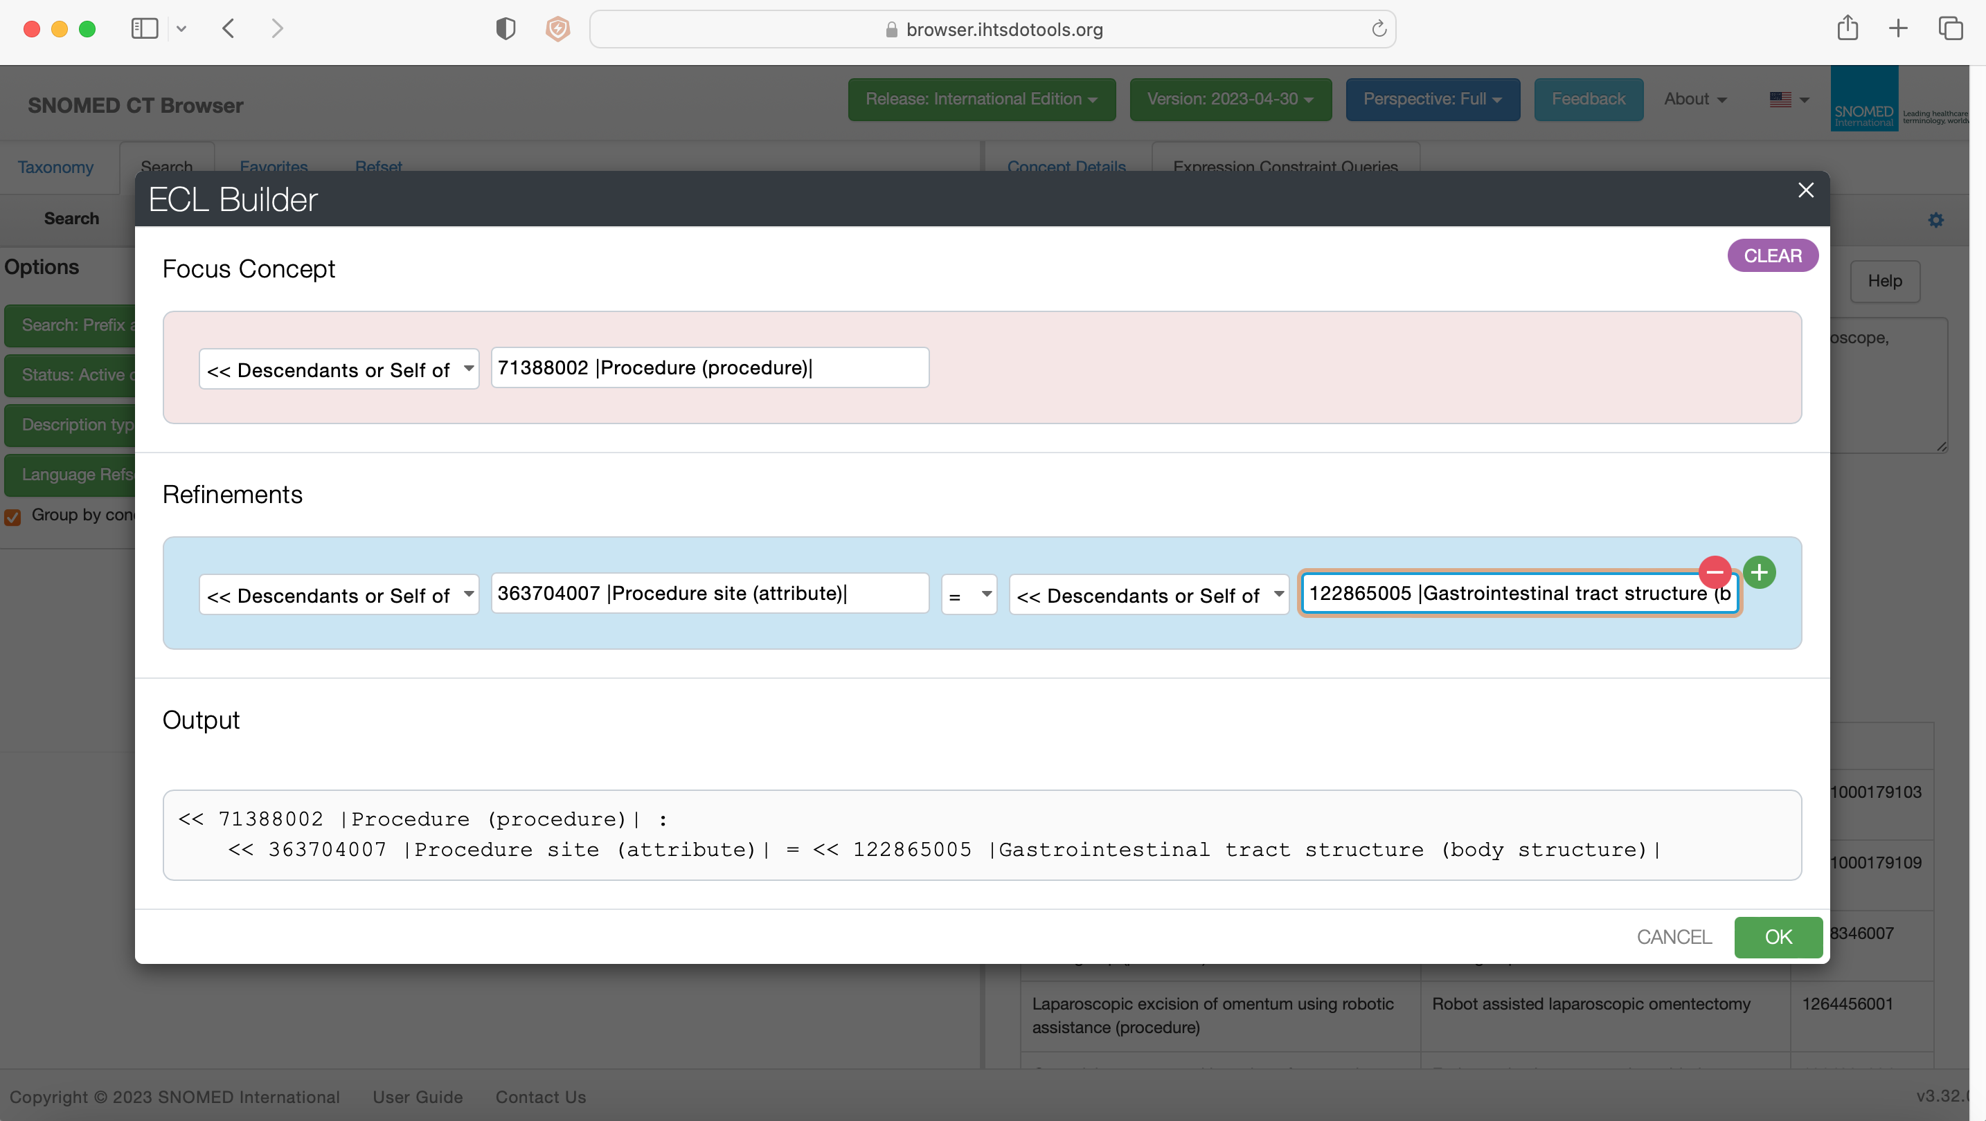

Slide 37
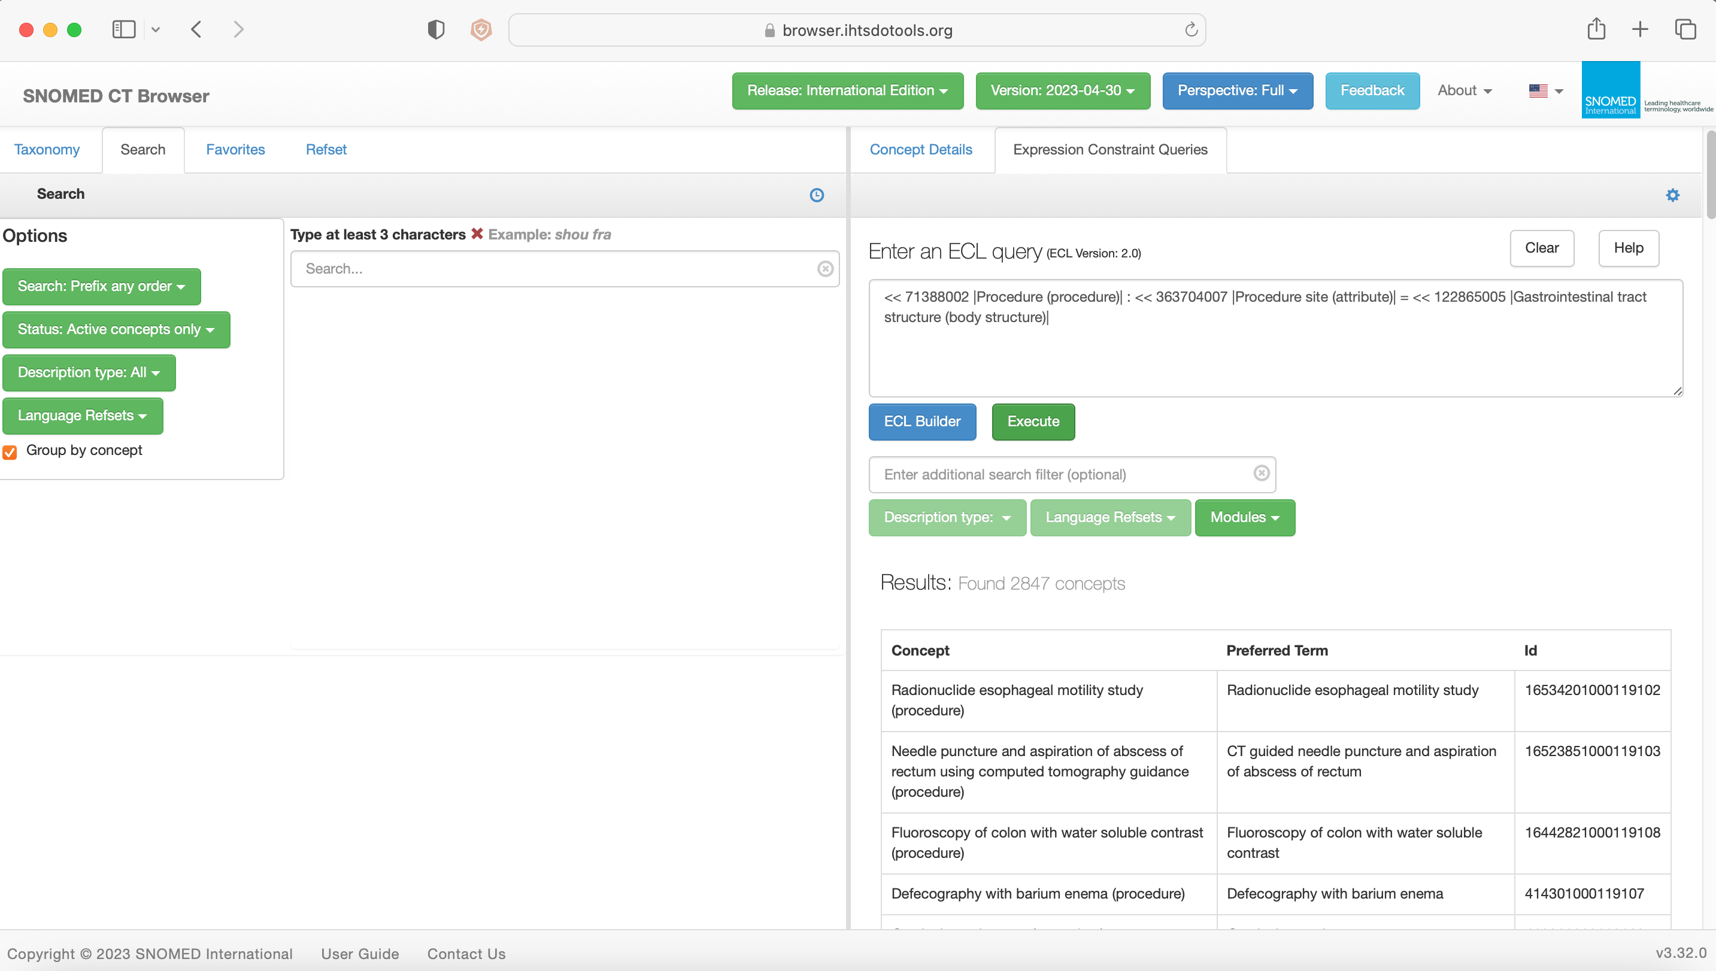

Slide 38
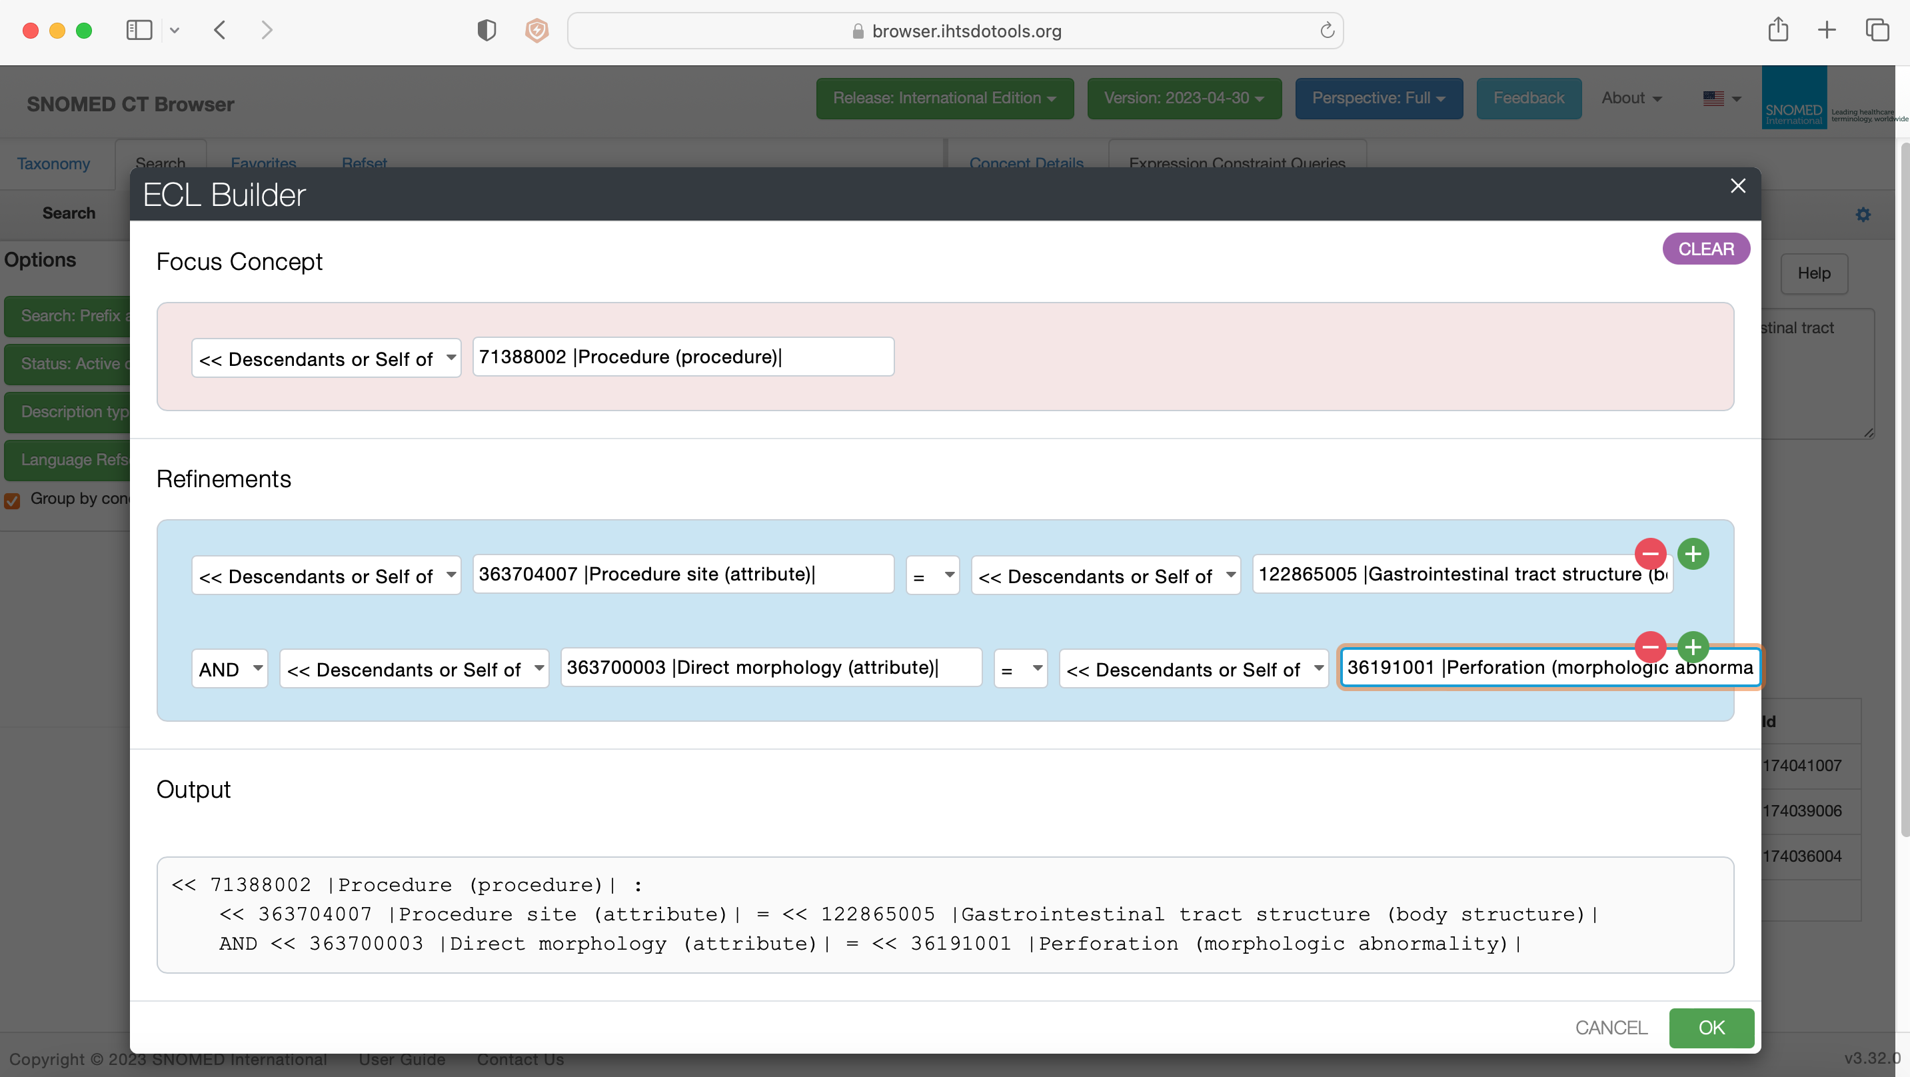

Slide 39
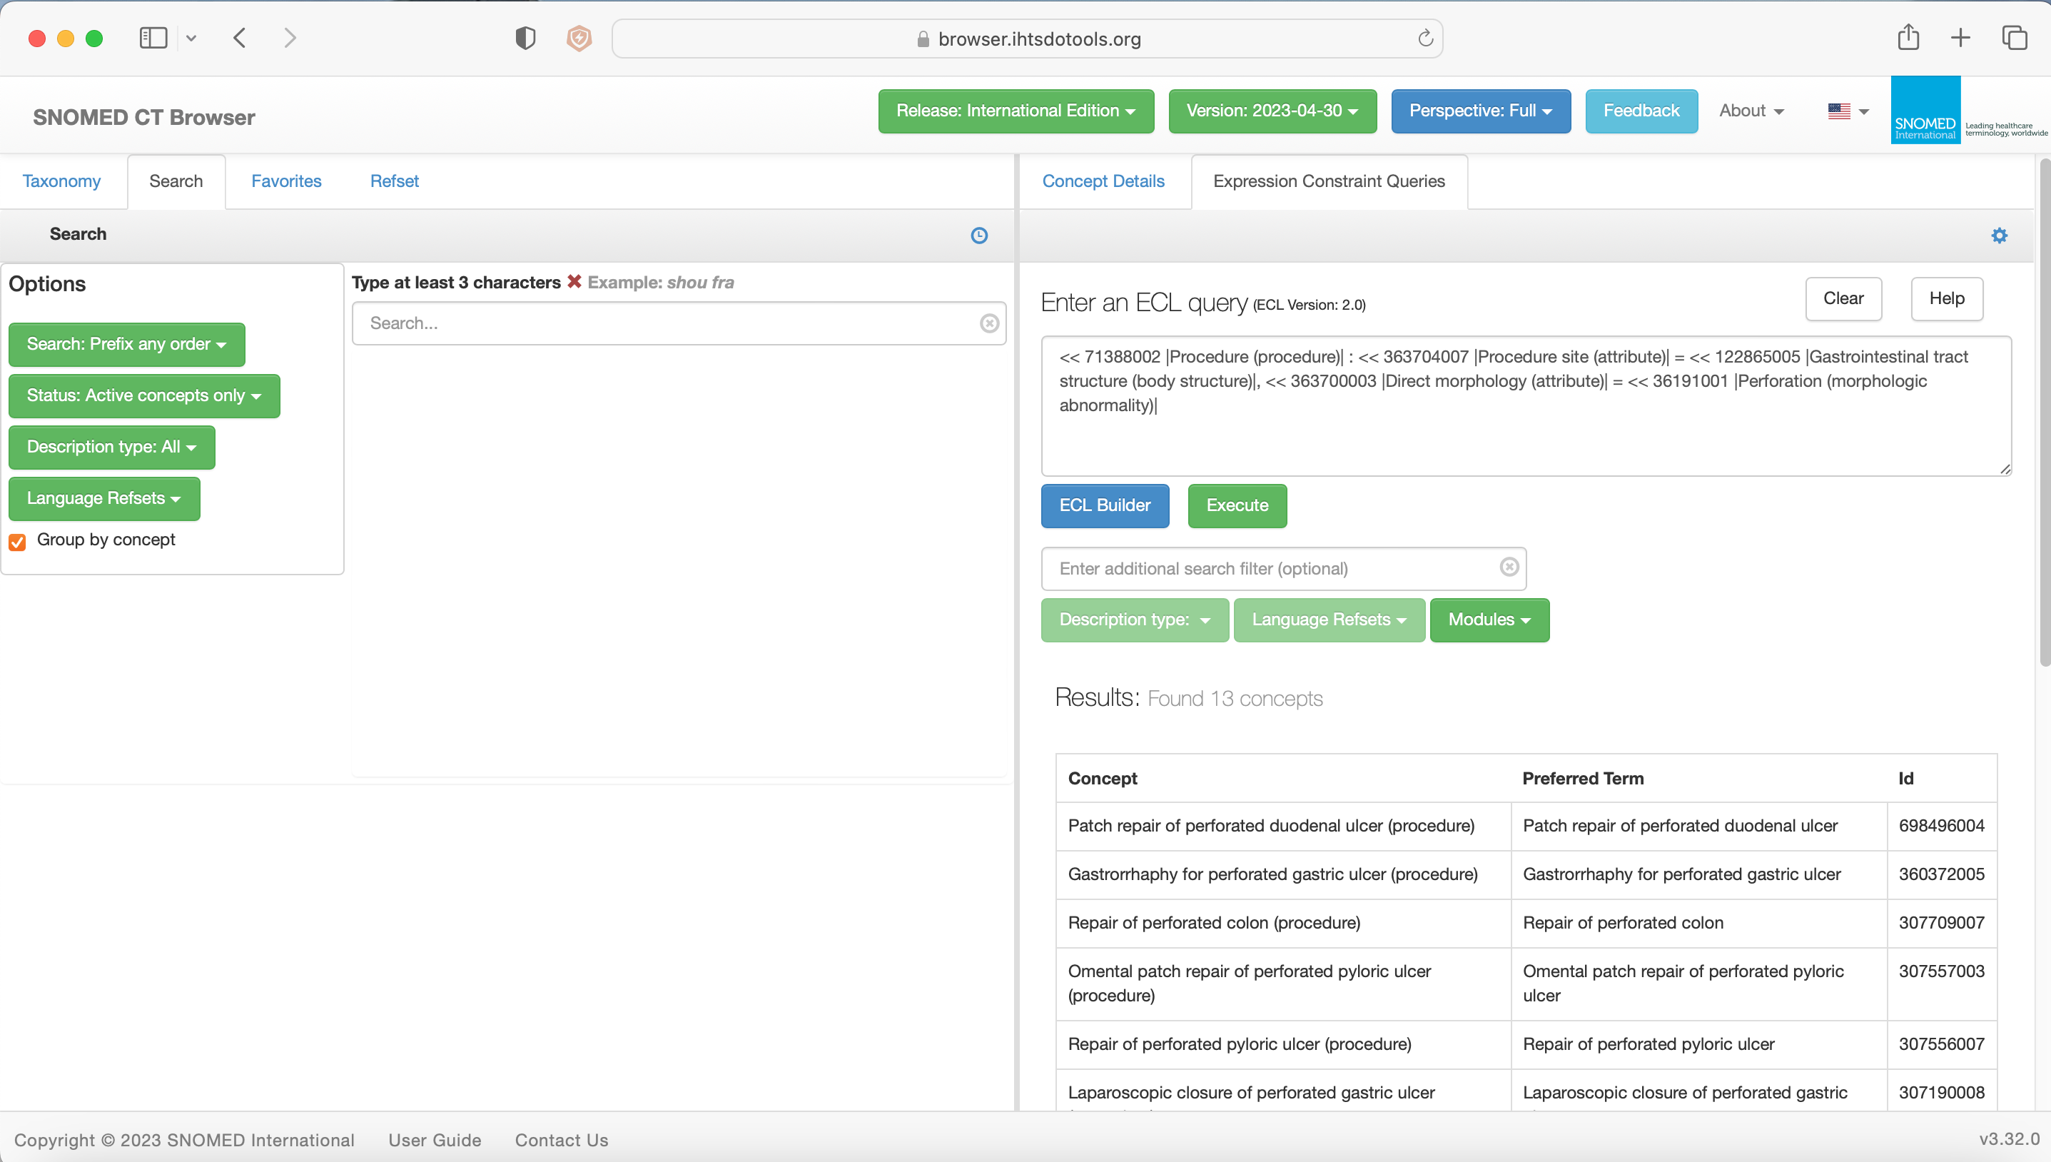

Slide 40
Show me all the COVID Vaccine
patients 5-30 days after vaccination
who attended the ED presenting
with any type of Thrombosis and
showed features of: low platelet count,
Raised FDPs and Platelet Factor 4
antibodies

Slide 41
Numbers of patient records analysed?

Slide 42
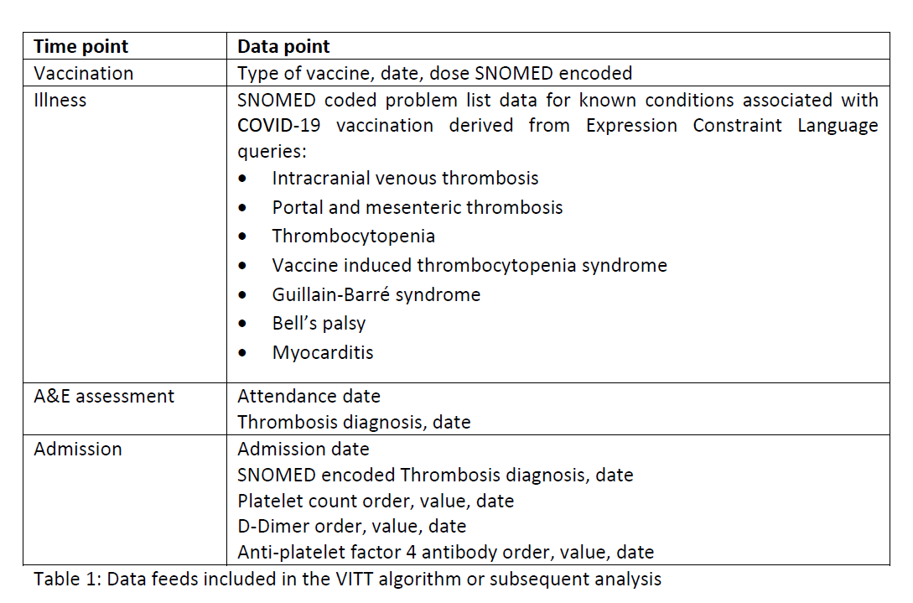
Methodology (data sources)
Primary care linkage
Barts Health Data Warehouse
Inclusion criteria:
Attended ED between 1st Dec 2020 and 1st July 2021
Over 18 years old
Registered with a local primary care practice i

Slide 43
Code finding
Electronic health records
Emergency care data set
Inpatient problem lists
Matching codes of value
SNOMED concept IDs
UK SNOMED extension queried using expression constraint language

Slide 44
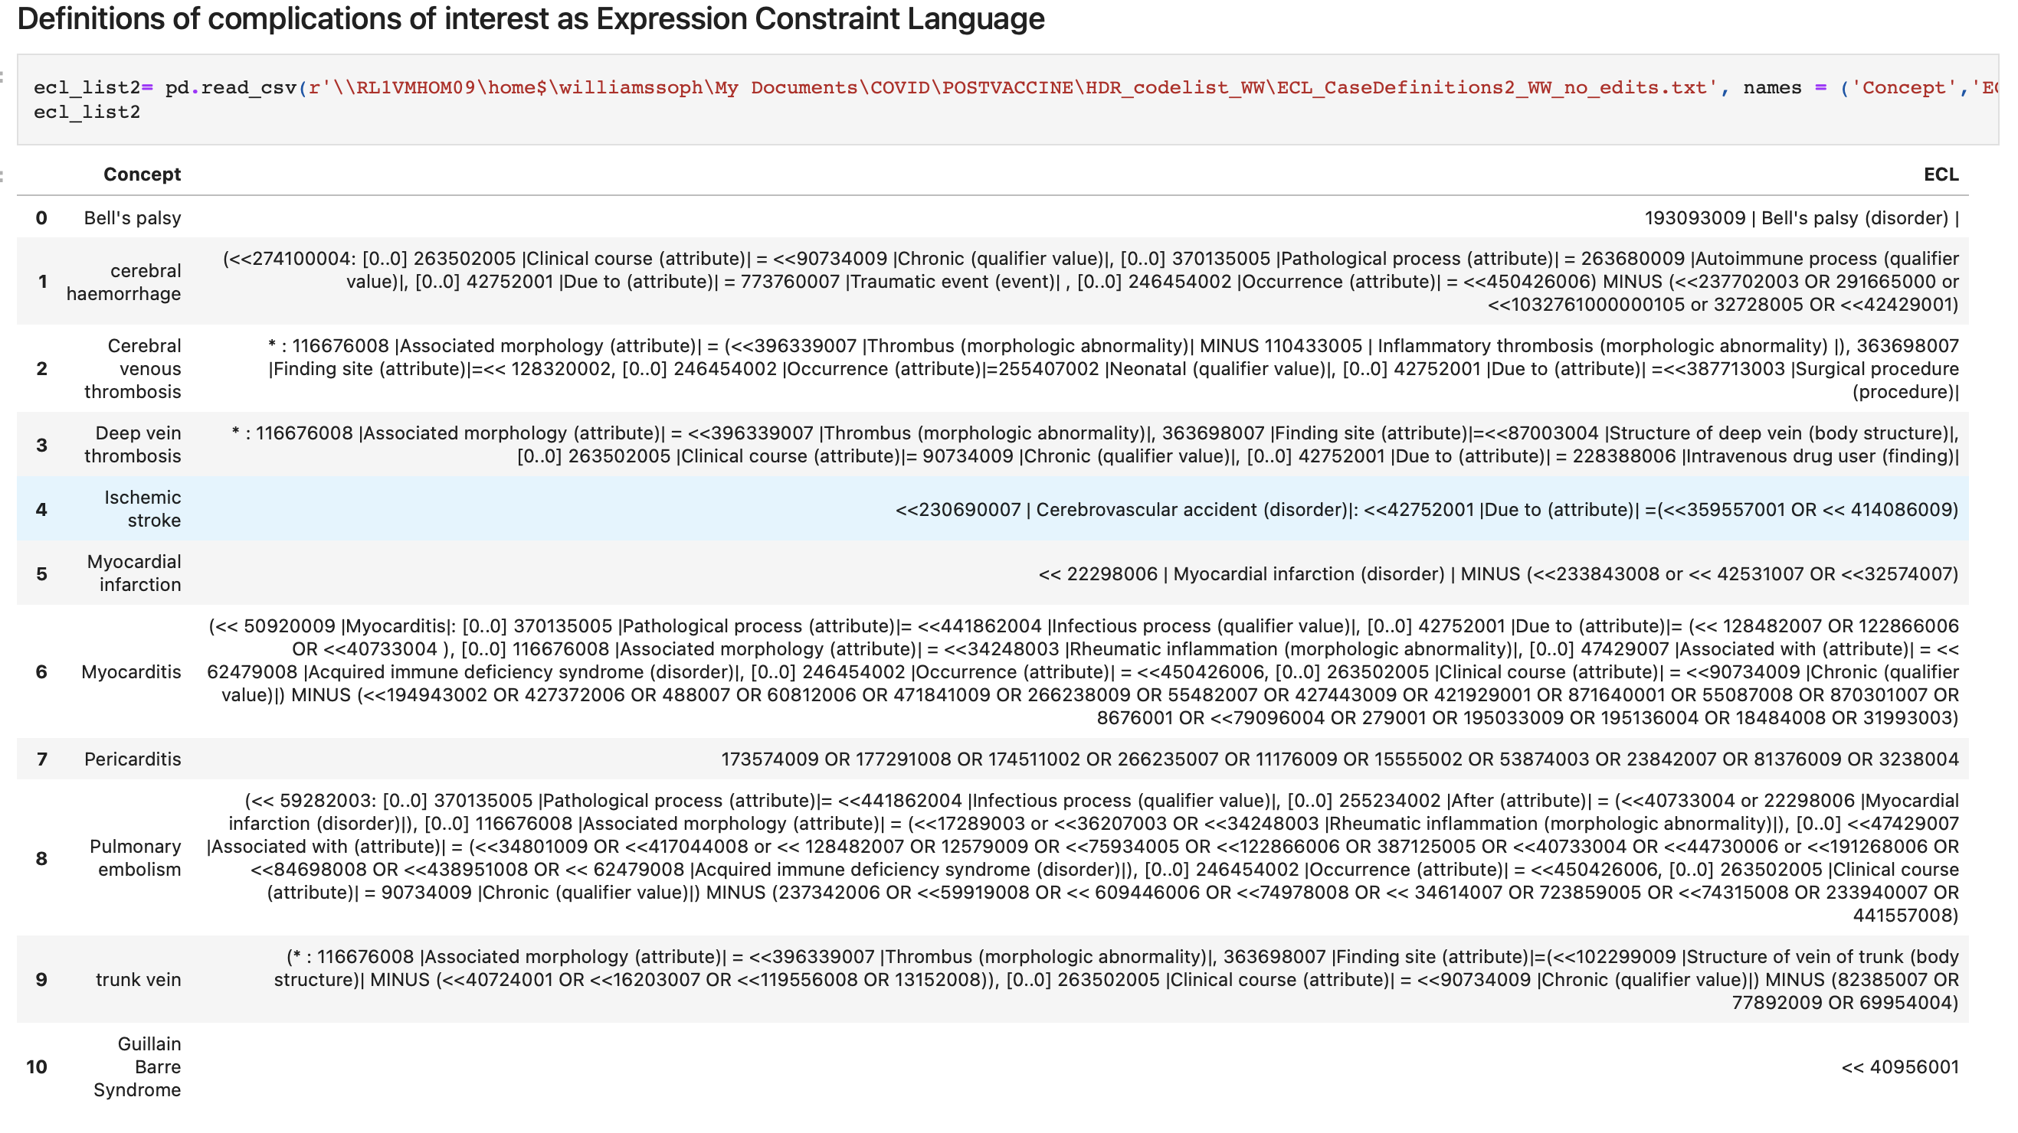
SNOMED ECL definitions
With filter to check for ECDS inclusion

Slide 45
Of people admitted to ED from 5 to 30 days of vaccination, how many VITT cases were identified with discharge data + laboratory data?
220
2
2
0
0
*
Admissions (n)
105,000
195,000
180,000
*reported to British Society of Haematology VITT group from regional hospitals

Slide 46
https://github.com>IHTSDO>health-data-analytics
THANK YOU
SNOMED International: Delivering SNOMED CT
Helpdesk – info@snomed.org
Charles Gutteridge - cgu@snomed.org

